Slide 1
JEOPARDY!
Juneteenth - state voices
June 2023

Slide 2
About Juneteenth
Two years after the Emancipation Proclamation was issued, General Order No. 3 was announced in Galveston, Texas on June 19, 1865 — finally enforcing the proclamation and freeing all remaining enslaved people in Texas. This day became known as Juneteenth, a celebration of Black freedom, independence, and culture.
Juneteenth became a federally recognized holiday in 2021, and now at least 28 states and Washington D.C. have recognized it as a public holiday. But recognizing Juneteenth is not enough — it must be paired with action.

Slide 3
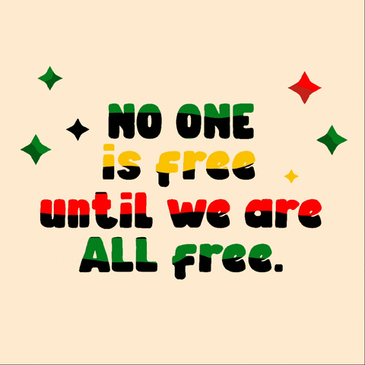
About Juneteenth
As we celebrate Juneteenth this year, let’s ground ourselves both in the history of this holiday and the journey we still have ahead of us to achieve the ideal that Juneteenth represents.
Learn more about the history of Juneteenth & how it became a federal holiday: nmaahc.si.edu/juneteenth
And play Juneteenth Jeopardy with your friends, family, and community to practice your knowledge!

Slide 4
Dates
Government
individuals
states
bonus
$200
$200
$200
$200
$2000
$400
$400
$400
$400
$2000
$600
$600
$600
$600
$2000
$800
$800
$800
$800
$2000
$1000
$1000
$1000
$1000
$2000

Slide 5
First Night Watch service took place this date.
Dates · $200

Slide 6
What is January 1, 1863?
Dates · $200

Slide 7
Juneteenth recognized as Federal Holiday.
Dates · $400

Slide 8
What is June 17, 2021?
Dates · $400

Slide 9
The first Juneteenth celebration was held on this date.
Dates · $600

Slide 10
What is 1866?
Dates · $600

Slide 11
Former slaves pooled $800 together through local churches to purchase 10 acres of land to create Emancipation Park to celebrate Juneteenth.
Dates · $800

Slide 12
What is 1870?
Dates · $800

Slide 13
According to the 1860 census, this percentage of the population represented the approximate amount of slaves throughout the United States.
Dates · $1000

Slide 14
What is 12%?
Dates · $1000

Slide 15
This is the name of the official announcement that was made to the slaves on Juneteenth.
Government· $200

Slide 16
What is
General Order #3?
Government · $200

Slide 17
She introduced House Bill # 7232 which recognizes Juneteenth as a Federal Holiday.
Government · $400

Slide 18
Who is
Rep. Sheila Lee-Jackson
Government · $400

Slide 19
This U.S. President signed a bill to recognize Juneteenth as a federal holiday.
Government· $600

Slide 20
Who is President
Joseph Robinette Biden?
Government · $600

Slide 21
This state was the first to recognize Juneteenth as a state holiday.
Government · $800

Slide 22
What is Texas?
Government · $800

Slide 23
This document legally freed enslaved Black people in America.
Government · $1000

Slide 24
What is the
Emancipation Proclamation?
Government · $1000

Slide 25
This U.S. President played a pivotal role in ending slavery in America.
individual · $200

Slide 26
Who is Abraham Lincoln?
Individual · $200

Slide 27
The largest Juneteenth celebration held here.
Individual · $400

Slide 28
What is Booker T. Washington Park?
Individual · $400

Slide 29
This individual led the efforts to make Juneteenth an official holiday in the state of Texas.
Individual · $600

Slide 30
Who is
State Rep.
Albert Edwards?
Individual · $600

Slide 31
This General made the announcement “all slaves are free.”
Individual · $800

Slide 32
Who is
General Gordon Granger?
Individual · $800

Slide 33
The first state to recognize Juneteenth as an official paid holiday.
States · $200

Slide 34
What is Texas?
States · $200

Slide 35
This state was the last to abolish slavery in 1865.
States · $400

Slide 36
What is Mississippi?
States · $400

Slide 37
This State Senator Pat Spearman, introduced legislation to make Juneteenth an official holiday.
States · $600

Slide 38
What is Nevada?
States · $600

Slide 39
George Floyd was choked for over 10 minutes and subsequently murdered by a former police officer in this state.
States · $800

Slide 40
What is Minnesota?
States · $800

Slide 41
Breonna Taylor was murdered in this state when officers were serving a no-knock warrant at her home.
States · $1000

Slide 42
What is Kentucky?
States · $1000

Slide 43
This flag was created in 1920 after Activist Marcus Garvey called for a Black Liberation
Bonus trivia · $2000

Slide 44
What is the Black Pan-African Flag?
Bonus trivia · $2000

Slide 45
He worked for the NAACP and became the first field secretary in Jackson, MS. He was murdered in June 1963.
Bonus trivia · $2000

Slide 46
Who is Medgar Evers?
Bonus trivia · $2000

Slide 47
These facilities were essential to keeping inner-city children busy while their parents worked for white families.
Bonus trivia · $2000

Slide 48
What are community centers?
Bonus trivia · $2000

Slide 49
In 1963, in Birmingham, Alabama, a dynamite bomb exploded in the back stairwells of this church, killing 4 Black girls.
Bonus trivia · $2000

Slide 50
What is
Sixteenth Street
Baptist Church?
Bonus trivia · $2000

Slide 51
He was accused of whistling at a white woman at a convenience store and was kidnapped, beaten and murdered.
Bonus trivia · $2000

Slide 52
Who is Emmett Till?
Bonus trivia · $2000

Slide 53
Winner!

